Slide 1


Generative AI using watsonx in IBM Cloud
Dhara Bagadia Data Scientist Ecosystem Engineering IBM India Software Labs

Slide 2
Agenda
Introduction to Generative AI
Overview of LLMs
Introduction to Watsonx
Demonstration of Watsonx
Case Studies in Generative AI
Notes:
This self-explanatory slide shows the topics covered in this presentation.

Slide 3
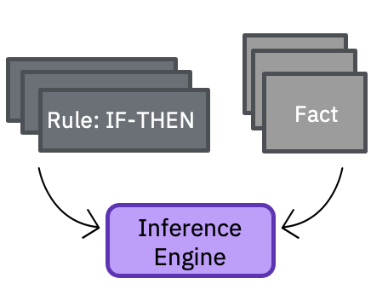
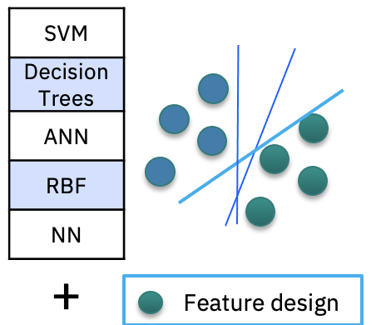
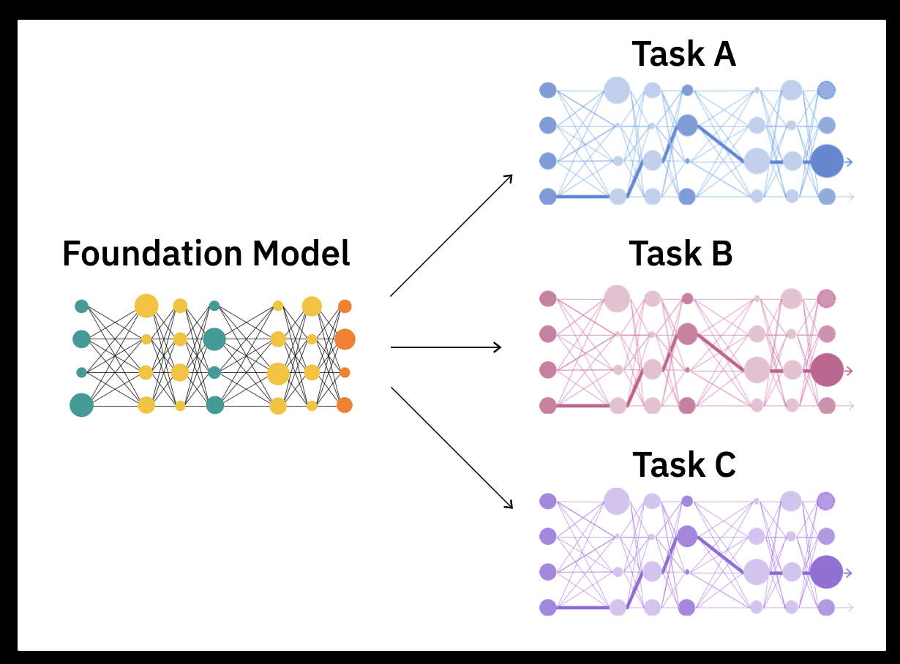
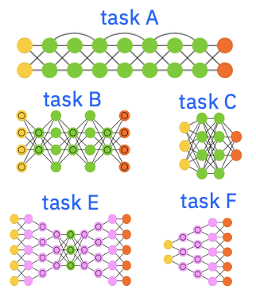
The story of AI is a story of data representations
1980s
Big data
1980s to ~2010s
Massive labeled data + Compute
2017+
Self-supervision at scale
+
Massive unlabeled data + Compute
Expert systems
Rule engines
Machine learning
ML algorithms
Task-specific decision boundaries
Deep learning
Network architectures
Task-specific decision boundaries + feature representations
Foundation models
Base model
Adaptable decision boundaries and feature representations

Slide 4
Foundation model libraries
Encoder
Decoder
Encoder-decoder
Powers search engines and customer-service chatbots, including IBM Watson Assistant.
Encoder-only models are widely used for non-generative tasks like classifying customer feedback and extracting information from long documents.
Encoders are not trained to predict, but rather to find & extract useful information from models trained with relatively smaller sets of data.
Google’s Bidirectional Encoder Representation from Transformer (BERT) is an example
Trained to predict the next word without an encoded representation.
Decoder-only models are used with chat platforms like ChatGPT to generate new responses, answers, or text based on simple input from customers.
Decoders are trained for predictive, generative tasks based on their massive pre-trained data sets.
The Generative Pre-Trained Transformer (GPT) is an example
Combines features of both encoder and decoder models.
They can do many of the generative tasks that decoder-only models can, but their compact size makes them faster and cheaper to tune and serve.
Google’s Text-to-Text Transfer Transformer (T5) is an example.
IBM watsonx.ai provides open
foundation models as well as IBM’s securely trained models including encoder, decoder, & encoder-decoder foundation models.

Slide 5

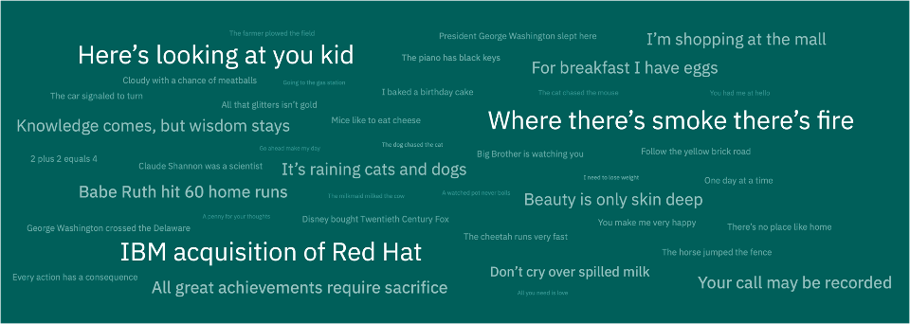
Foundation models are …
Pre-trained
On unlabeled datasets of different modalities (e.g., language, time-series, tabular)
Self-learning
Systems that leverage self-supervised learning
Self-supervised
training
Multiple applications
Able to learn generalizable and adaptable data representations that can be effectively used in a variety of domains and tasks (code generation, question answering, sentiment analysis)
Large language models
A type of foundation model trained withy language-related data
ChatGPT is based on a large language model
Foundation model

Slide 6
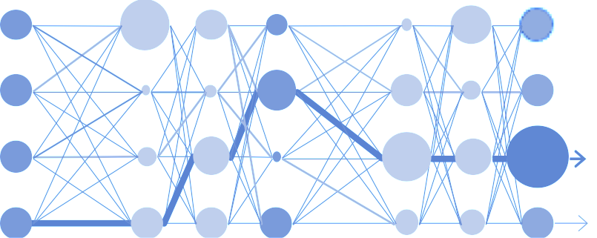



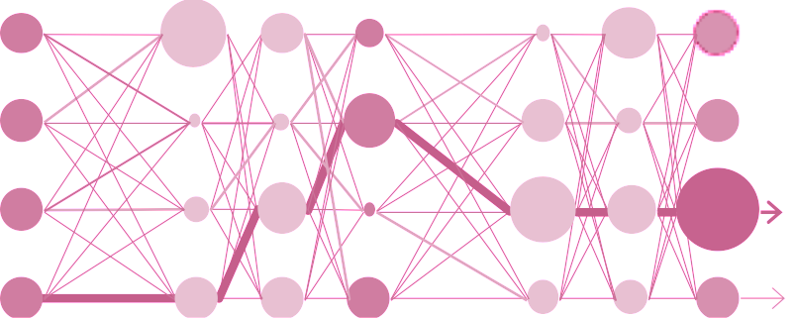

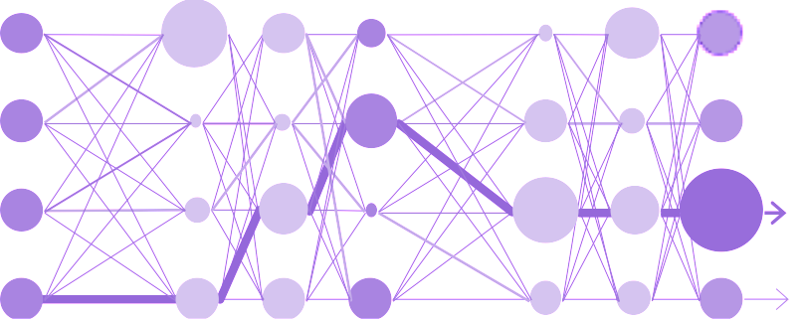

Foundation models: Generalizable and adaptable
Foundation model
Self-supervised
training
Translation
model
Task-specific
fine-tuning
+
Summarization
model
Answer finding
model

Slide 7
Foundation models: Generalizable and adaptable
Foundation model
Self-supervised
training
Translated input
Translation prompt
Summarization prompt
+
Input text
+
Summarized input
Answer finding prompt
Answer to the input question

Slide 8
IBM POV: Four core principles to tailor generative AI for enterprise
Open
Targeted
Trusted
Empowering
→ Based on the best AI and cloud technologies available.
→ Designed for targeted business use cases, that unlock new value.
→ Offering security and data protection.
→ On a platform to bring your own data and AI models that you tune, train, deploy, and govern.
→ Built with governance, transparency, and ethics that support increasing regulatory compliance demands.
→ Giving access to the innovation of the open community and multiple models.
→ Including curated models that can be tuned to proprietary data and company guidelines.
→ Running anywhere, designed for scale and widespread adoption to truly create enterprise value.

Slide 9
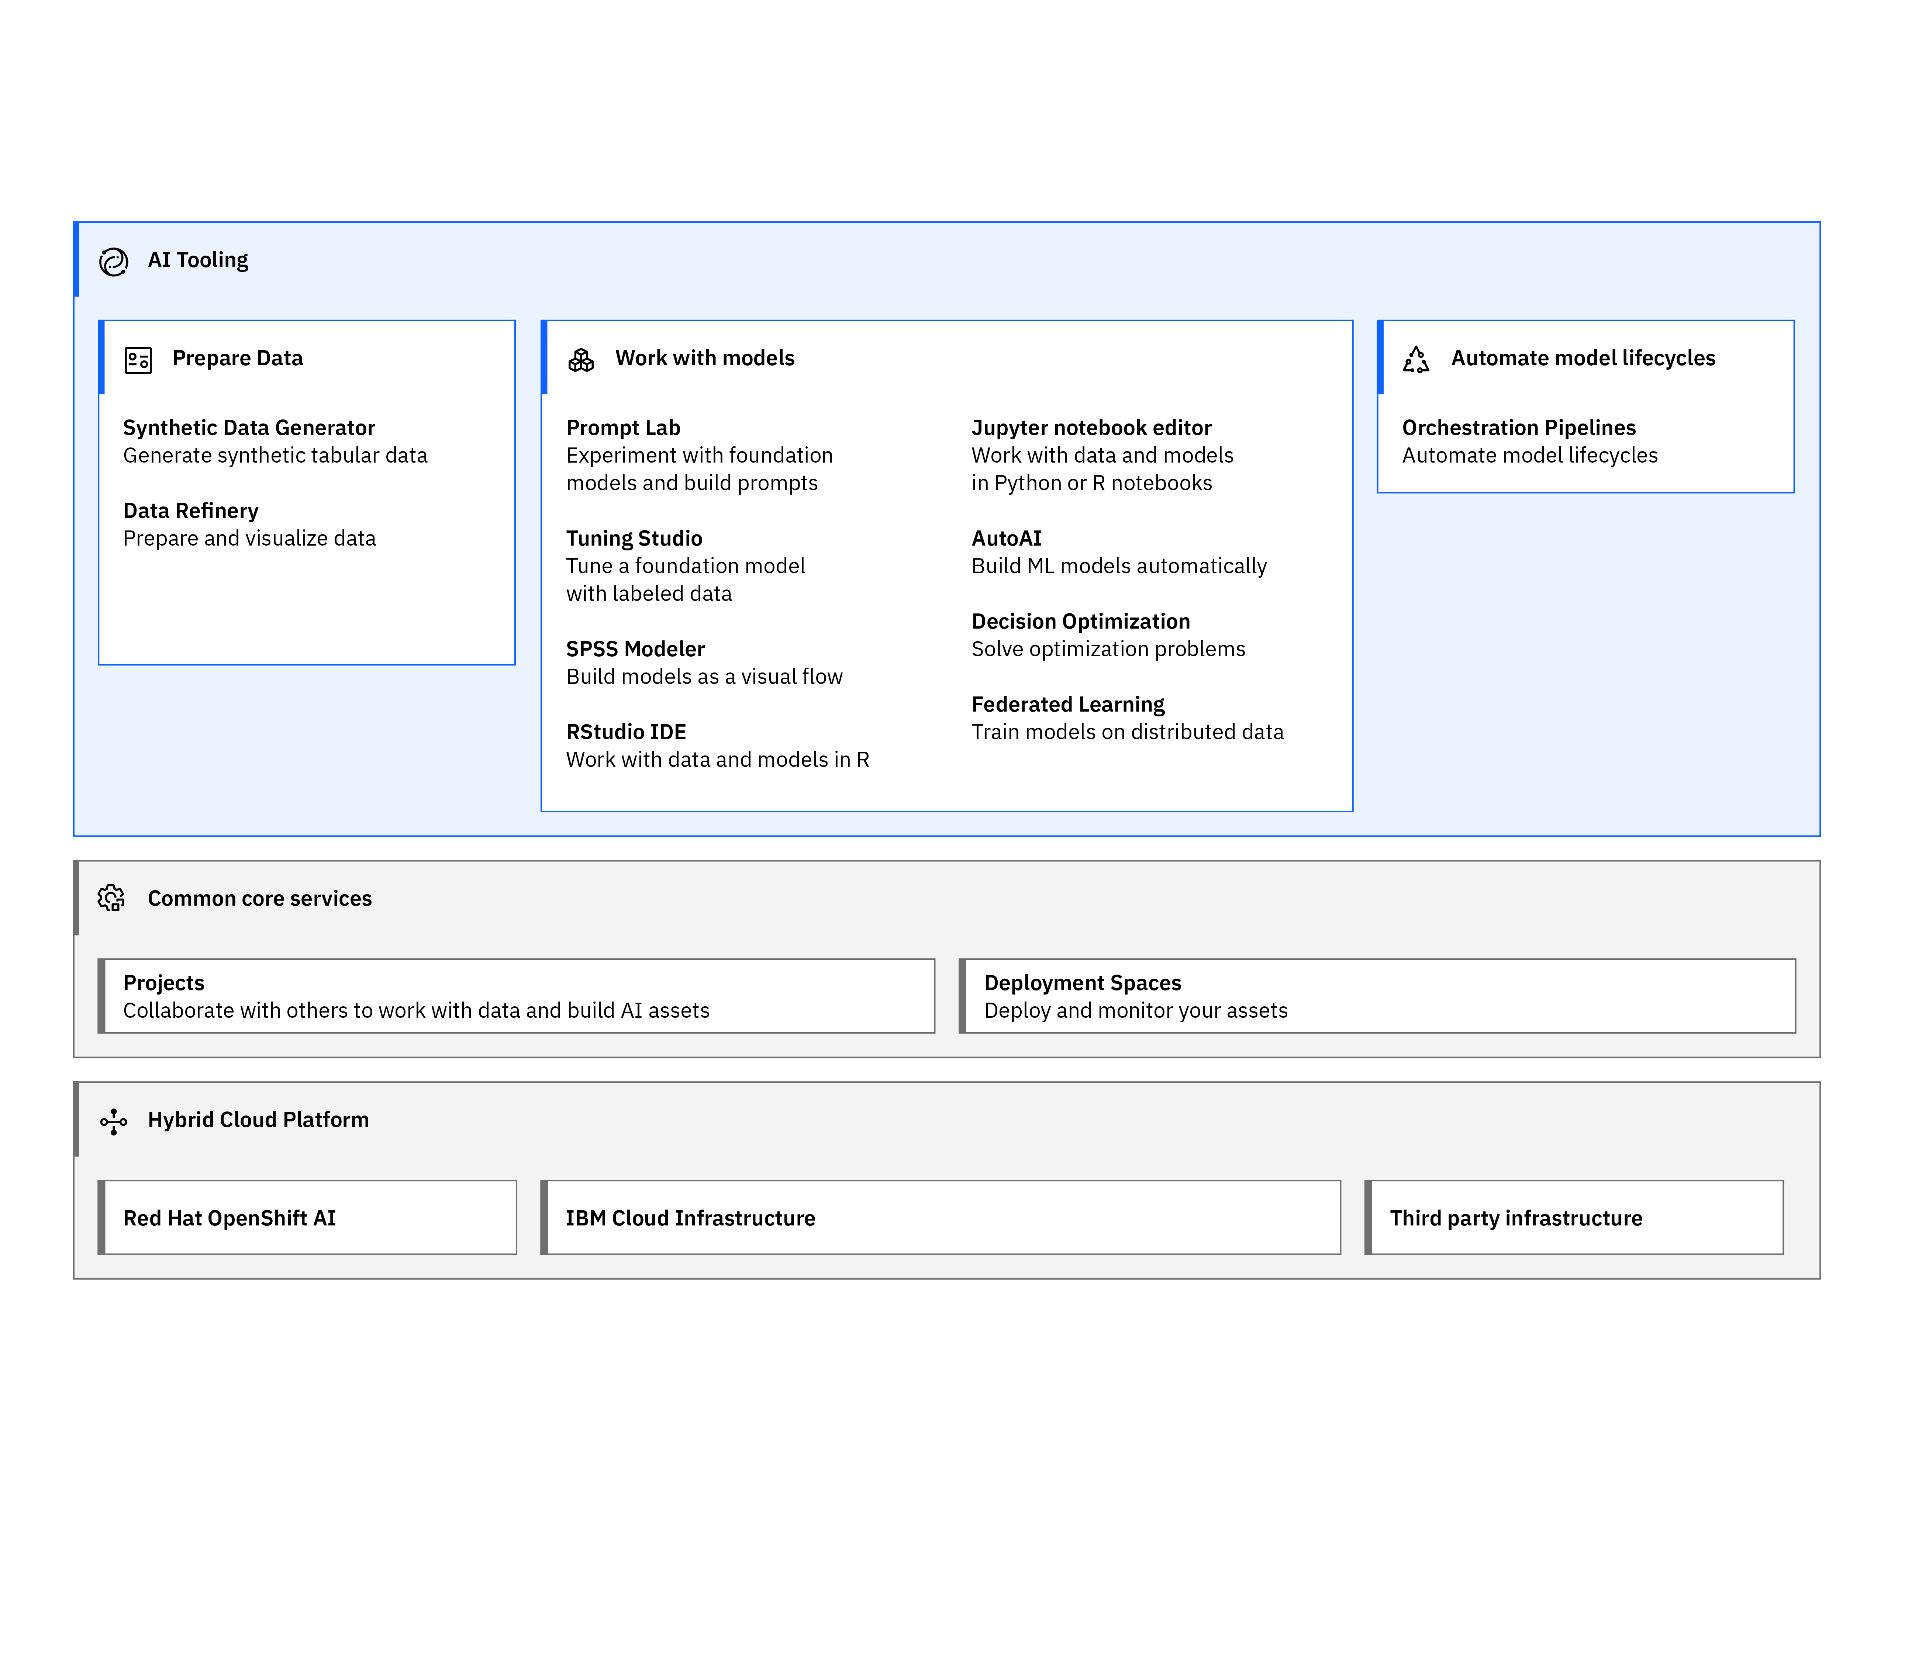
IBM watsonx.ai architecture
Common core services
Collaborative projects
Deployment spaces
Jobs
Notifications
Common connectivity
Access and Authentication
Resource management
Central asset management system

Slide 10

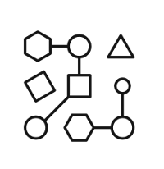

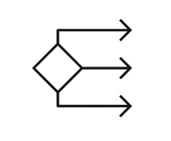


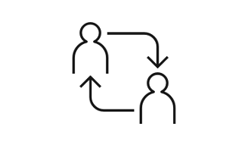
watsonx.ai
Train, validate, tune, and deploy AI models with confidence
Generative AI capabilities
Plus, a proven studio for machine learning
Foundation model library
ModelOps
Automated development
Prompt Lab
Decision optimization
Tuning Studio*
Team collaboration and data preparation

Slide 11
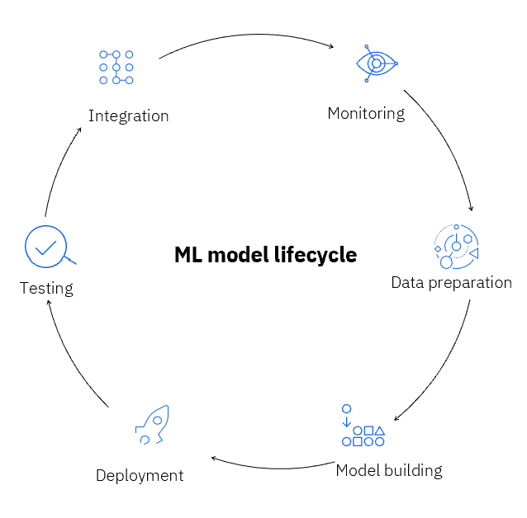
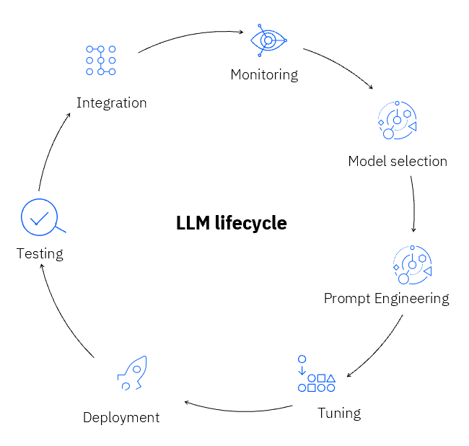
LLM and ML model lifecycle
watsonx.ai

Slide 12
Prompts
Prompt is a mode of interaction between human and LLM which enables model to generate output. It can be in various forms like text, questions, code examples etc.,
Types Of Prompts
Completions:
Description: Completions involve providing a partial sentence or phrase and asking the model to complete it.
Example: If the partial sentence is "The quick brown fox jumps over the", the model might complete it with "lazy dog."
Instructions:
Description: Instructions are explicit commands or directives given to the model, instructing it on what kind of response is expected.
Example: An instruction prompt could be "Translate the following English sentence into French: 'Hello, how are you?'"
Questions:
Description: Questions prompt the model to provide an answer or response to a specific query.
Example: "What is the capital city of France?"

Slide 13
Prompt Guidelines
Provide Context
Be Specific
Define Intent & Output
Give Examples
Positive & Negative Instructions
Try Chain of Thought - break down a complex “thought”
Adjust Parameters

Slide 14
Take advantage of both traditional and Next-Gen AI Models in watsonx.ai
Architecture model
Traditional AI
Generative AI
Zero-shot Prompting
Few-shot Prompting
Data-driven Tuning
1000s — 1000000s labeled data points / task
No labeled data needed
1-10 labeled data points / task
100s - 1000s labeled data points / task
Task
Task
Task
Task
Task
Task
Task
Task
Model
Model
Labeled Tuning data
Handcraft examples
Labeled
Training
Data
Labeled
Training
Data
Pre-Trained Foundation model
Supports both conventional NLP tasks and new human + AI, iterative workflows

Slide 15
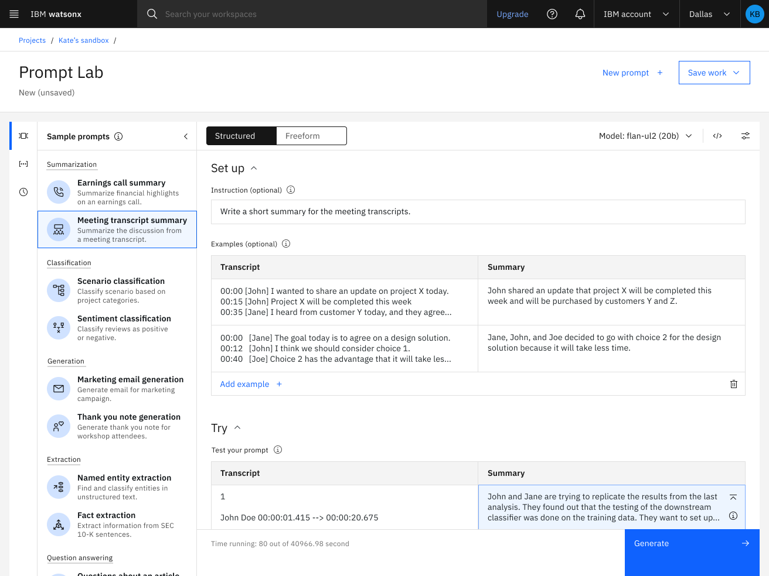
watsonx.ai: Prompt Lab Experiment with foundation models and build prompts
Interactive prompt builder
Experiment with prompt engineering
Includes prompt examples for various use cases and tasks
Experiment with different prompts, save and reuse older prompts, use different models, and vary different parameters
Experiment with zero-shot, one-shot, or few-shot prompting to get the best results
Choice of foundation models to use based on task requirements
Prevent the model from generating repeating phrases
Number of min and max new tokens in the response
Stop sequences – specifies sequences whose appearances should stop the model
© 2023 IBM Corporation
Notes:
IBM watsonx.ai offers a prompt lab, where users can interact with different prompts using prompt engineering on generative artificial intelligence (AI) models for both zero-shot prompting and few-shot prompting. This allows users to accomplish different natural language processing (NLP) functional tasks and take advantage of IBM vetted pre-trained open-source foundation models (FMs). Encoder-decoder and decoder-only large language models (LLM) are available in the prompt lab today.
Capabilities within the Prompt Lab include:
Summarize: Transform text with domain-specific content into personalized overviews and capture key points (e.g., sales conversation summaries, insurance coverage, meeting transcripts, contract information)
Generate: Generate text content for a specific purpose, such as marketing campaigns, job descriptions, blogs or articles, and email drafting support.
Extract: Analyze existing unstructured text content to surface insights in specialized domain areas, such as audit acceleration, SEC 10K fact extraction, and user research findings.
Classify: Read and classify written input with as few as zero examples, such as sorting of customer complaints, threat and vulnerability classification, sentiment analysis, and customer segmentation.
Question & Answering (Q&A): Based on a set of documents or dynamic content, create a Q&A feature grounded on product specific content, such as building a Q&A resource from a broad knowledge base to provide customer service assistance.

Slide 16
Thank You

Slide 17

https://ibm.biz/SB4A-Edunet-AICTE-Internship

Slide 18
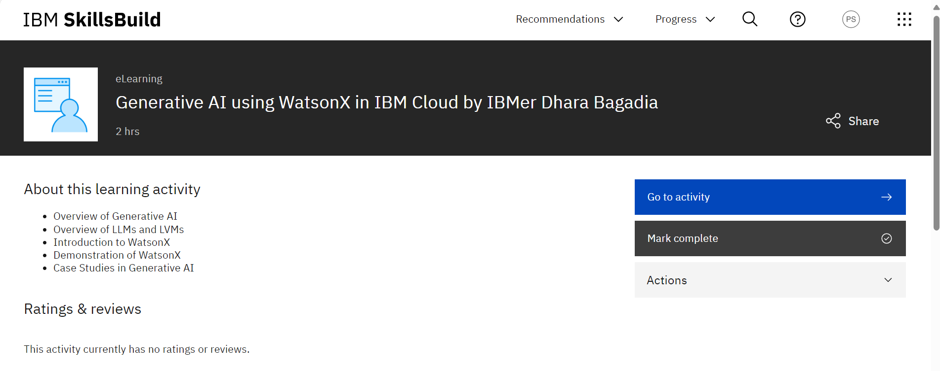

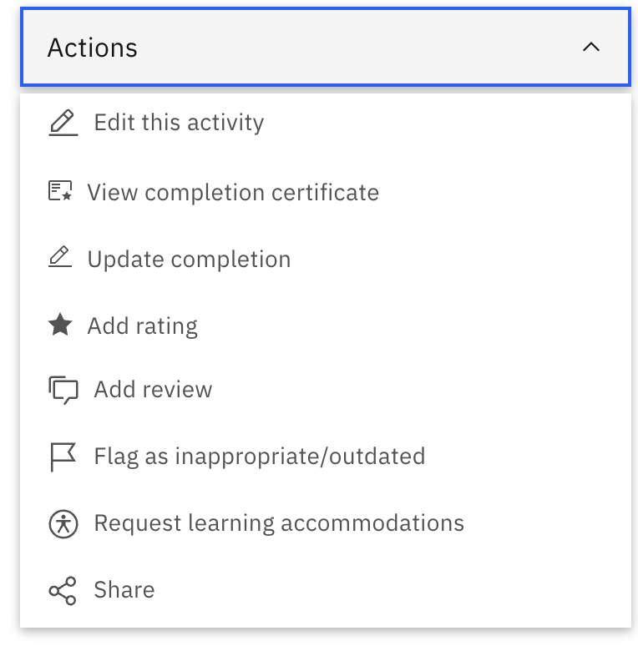
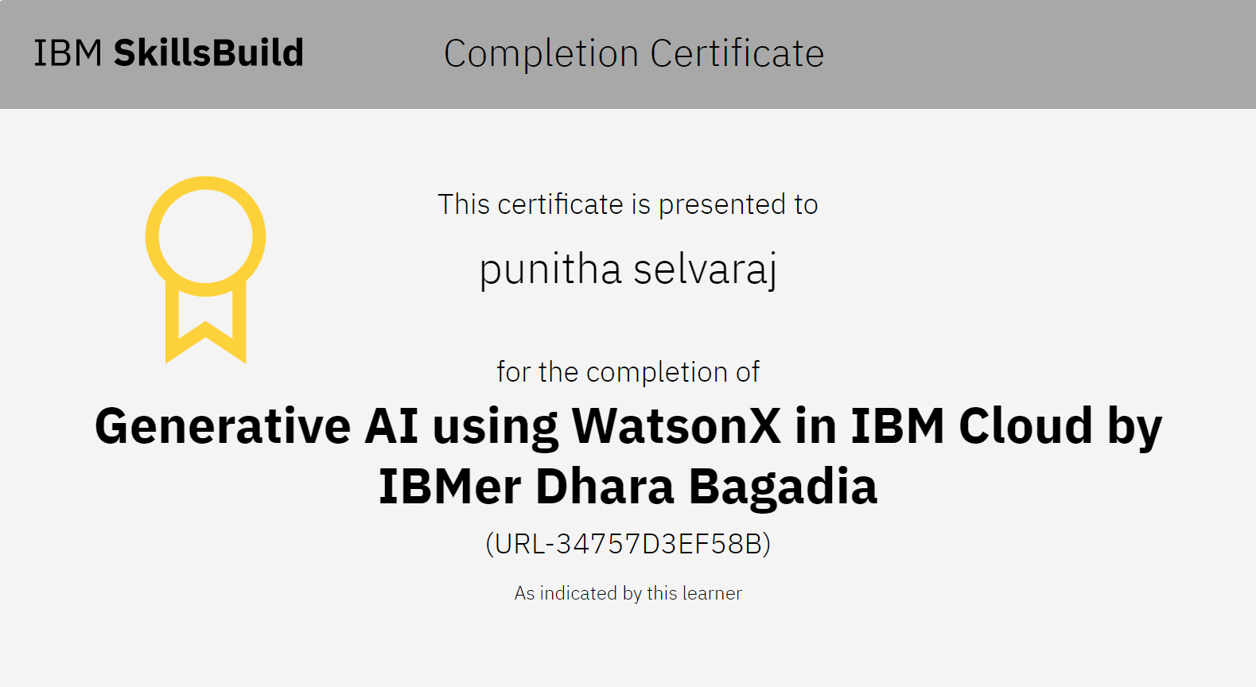
Student Process
NEW
https://ibm.biz/SB4A-Edunet-AICTE-Internship

